Slide 1

Enhancing Healthcare Accessibility in Nairobi County

Slide 2
Introduction
Health care in Nairobi has come a long way with increased healthcare facilities within the region in the last few years. This however does not give the full picture and therefore we cannot conclude that the increase in number directly correlates to an increase in accessibility.
We will investigate if the number of health facilities directly correlates with healthcare accessibility in the County and Sub-counties.
Our goals will be to
Determine if the population has access to government-backed health facilities that can offer access to cheaper health services and when government sensitization and drives are required.
What is the distribution of the health care facilities across the county and sub-counties?
Determine the number and nature of health facilities accessible to a given population in the sub-counties.

Slide 3
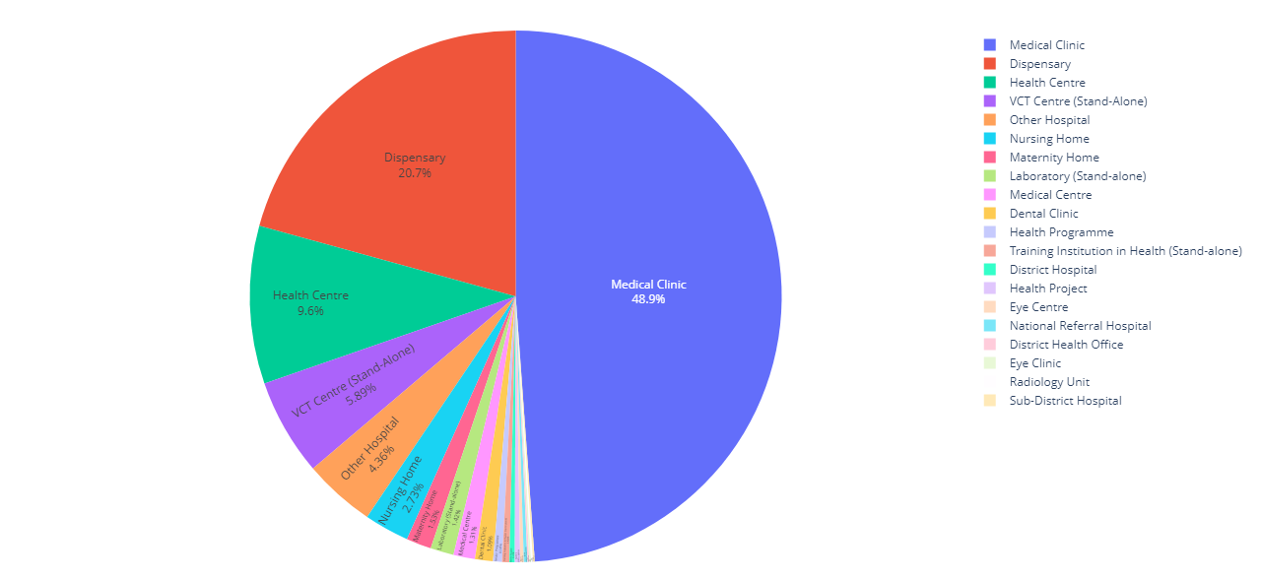
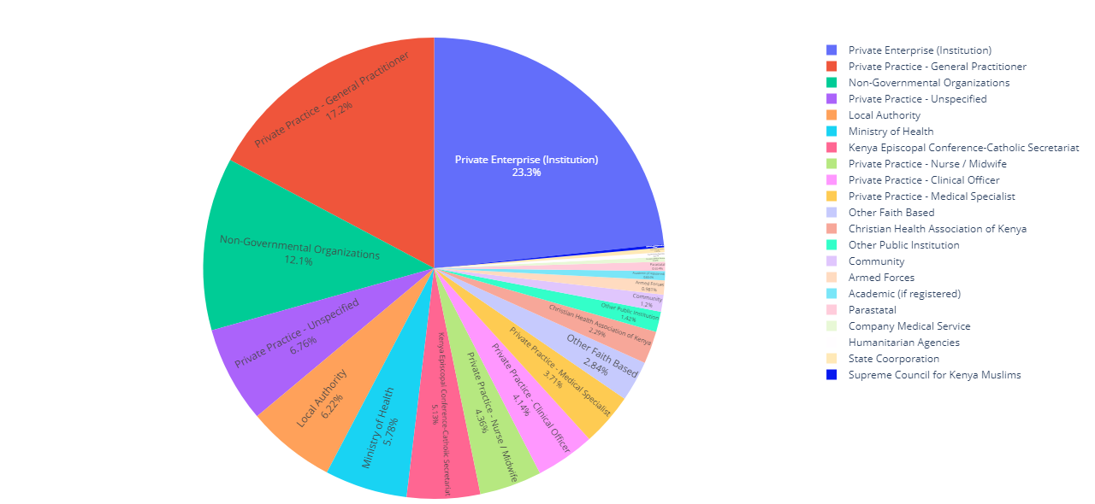
County Level Analysis
Using the health facility data and filtering out facilities within the county, we can conclude that about 917 operational health facilities in Nairobi County serve a population of 4,397,073 people.
49% of the health facilities are medical clinics, 20% are Dispensaries and 10% are health centers. However, there are only 2 National referral hospitals in one of the country's most populated counties.
Private institutions own 23% of all the hospitals, 17% are private practice facilities, 12% are owned by NGOs, while facilities owned by local authorities and the Ministry of Health are 5th and 6th with approximately 6% each.

Slide 4
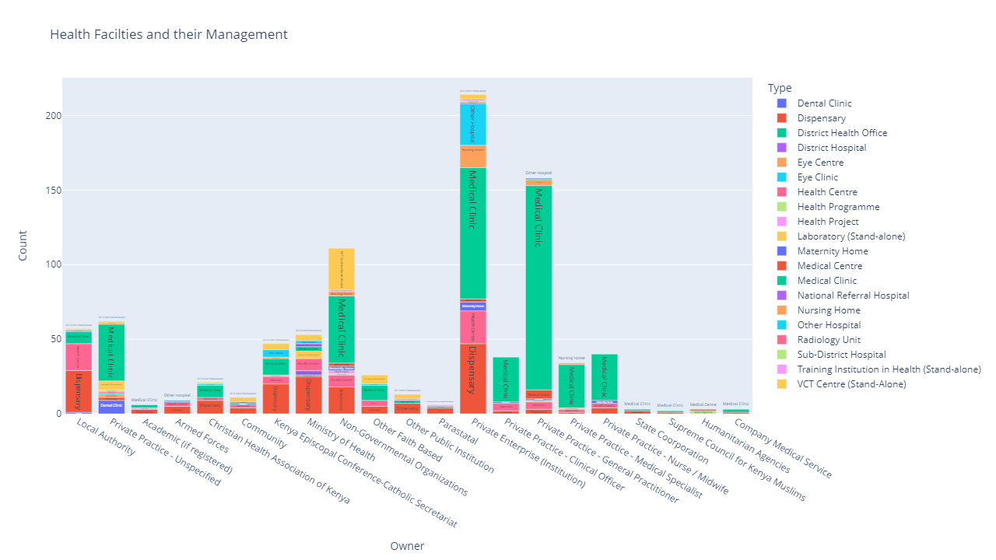
Most public health facilities are dispensaries while larger health centers, national, district and sub-district hospitals are fewer. This shows that the private sector has a larger presence which can lead to long queues for people looking to access cheaper public health services.

Slide 5
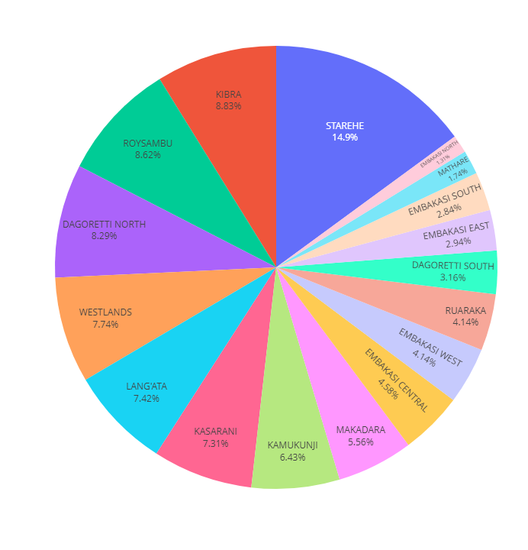
Sub County Analysis
At the sub-county level, we can use our hospital data together with population data, I, however, add a disclaimer here in that, the population data collected in 2019 used older sub-county administrative boundaries which are not captured in the health facility data, As such, I merged the Dagoretti and Embakasi sub-counties to capture the total number of health facilities in those areas. Njiru sub-county population data however was not correlated with the health facilities.
Health facilities here are fairly distributed with Starehe having the most health facilities at 14%, Embakasi North and Mathare at the tail end with 1.3% and 1.7%, respectively.

Slide 6
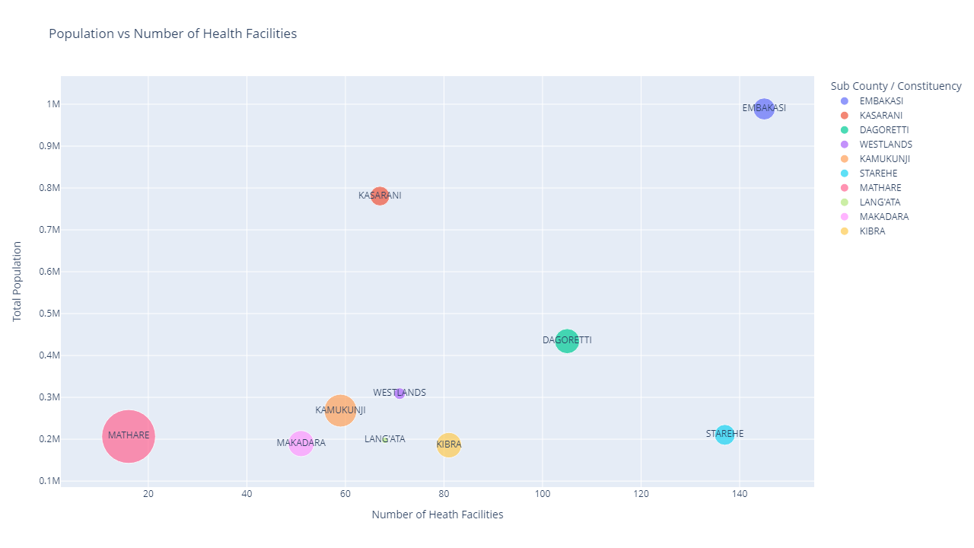
Taken together with population data we observe that Embakasi has the highest population and the highest facilities, with Starehe having a high number of facilities but low population and Mathare having a low population and low facilities but the highest population density.

Slide 7
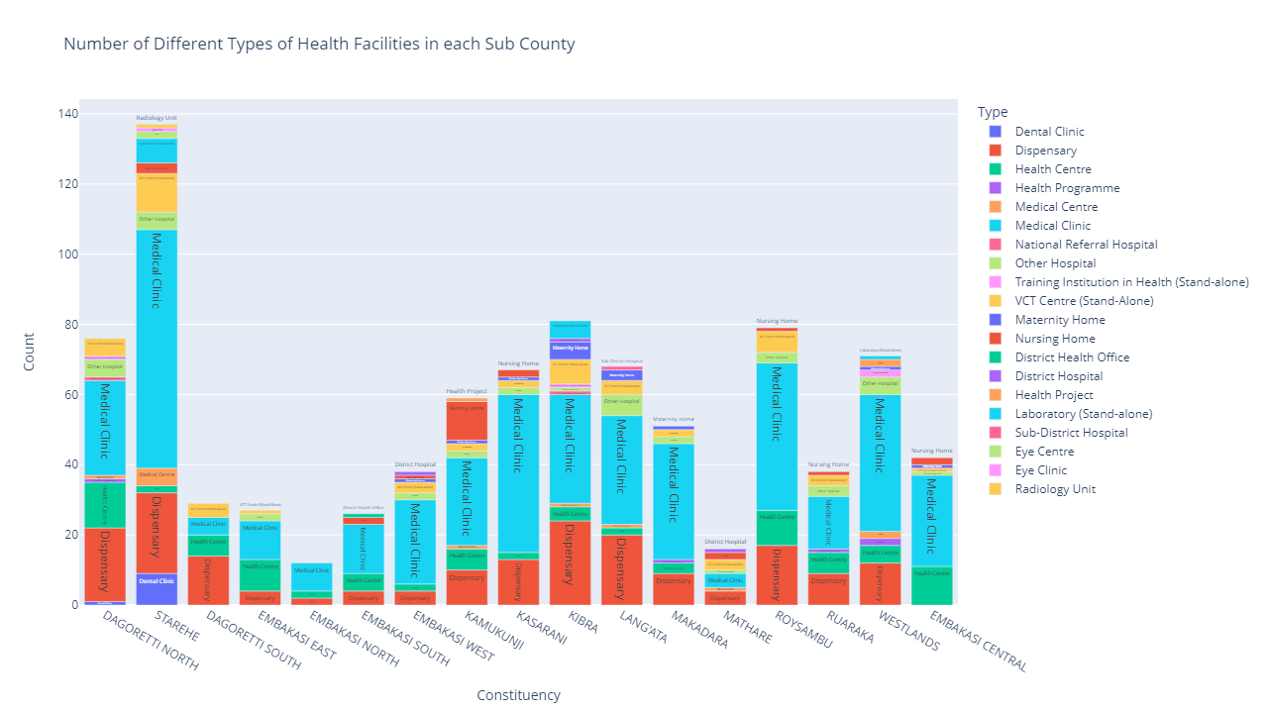
Looking at the different types of health facilities, medical clinics are well distributed across the sub-counties followed by dispensaries.

Slide 8
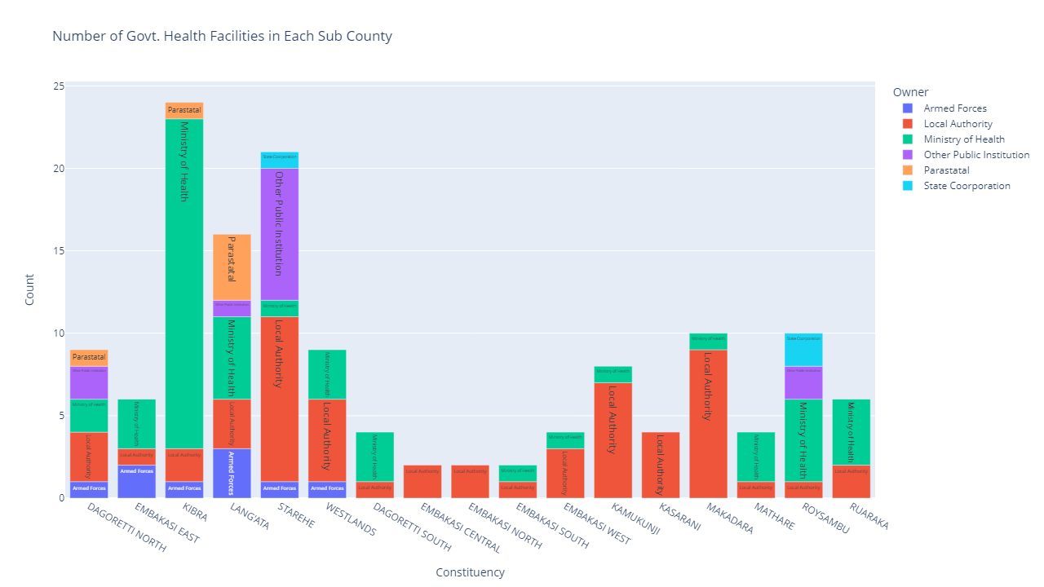
However, looking at the distribution of government-backed health facilities across the sub-counties, we can observe that there are less than ten facilities in most counties serving many people.

Slide 9
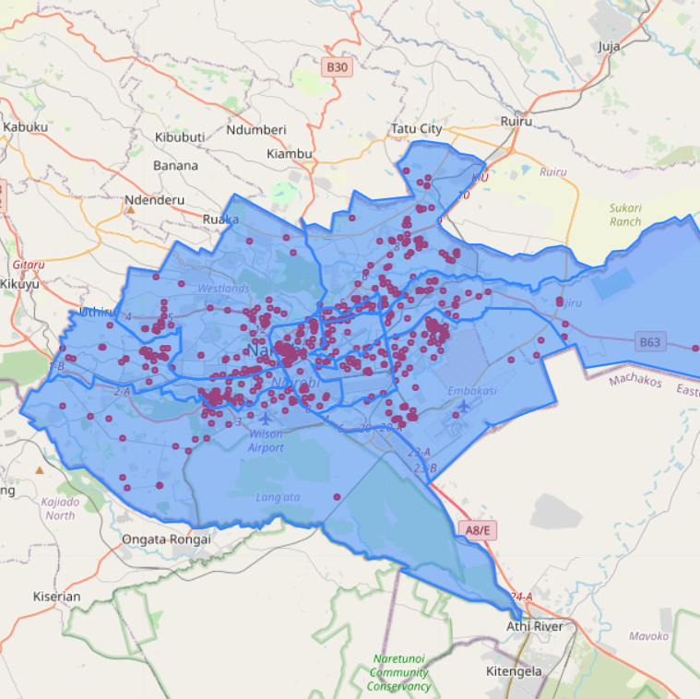
To see how the hospitals are distributed across the county and sub-counties the hospital data was geocoded using Google Maps API, this resorted to 610 facilities out of the 917 being geocoded and losing out on 307 of the hospitals.
These were mapped onto a Nairobi Sub Counties shapefile. Most of the facilities are located towards the central and northeastern side of the county. The trailing edges of the county have fewer facilities. This however is inconclusive data.

Slide 10
Recommendations
Having looked at the data the following recommendations can be made which align with the UN SDG3 of Good Health and Wellbeing
More investment in government back health care facilities. Especially in highly populated low-income areas
More National referral hospitals in Nairobi County for advanced healthcare needs
Distribution of the health facilities to allow easier access by citizens.
More drug recovery centers as no distinct ones were observed in the data.

Slide 11

Thank You

